Slide 1
Portrait Lighting
5 Lighting Portrait Lighting Techniques
Broad Lighting
Short Lighting
Butterfly Lighting or Paramount Lighting
45 Degree or Rembrandt Lighting
Loop Lighting

Slide 2
Broad Lighting
Broad Lighting. Broad lighting is when the main light is positioned in such a way that it illuminates the side of the face that is turned toward the camera.
This technique is used mainly for corrective purposes. It will de-emphasize facial features and is used mostly to make thin, narrow faces appear wider.
Understanding Broad and Short Lighting in Photography

Slide 3
Short Lighting
Short Lighting is when the main light illuminates the side of the face that is turned away from the camera.
This technique is used when the subject has an average oval face. Short lighting emphasizes facial contours more than broad lighting.
This narrow lighting is especially good for use in low-key portraiture. Because short lighting has a narrowing effect, it is great for use with subjects that have particularly round or plump faces.
Short & Broad Lighting In Portrait Photography

Slide 4
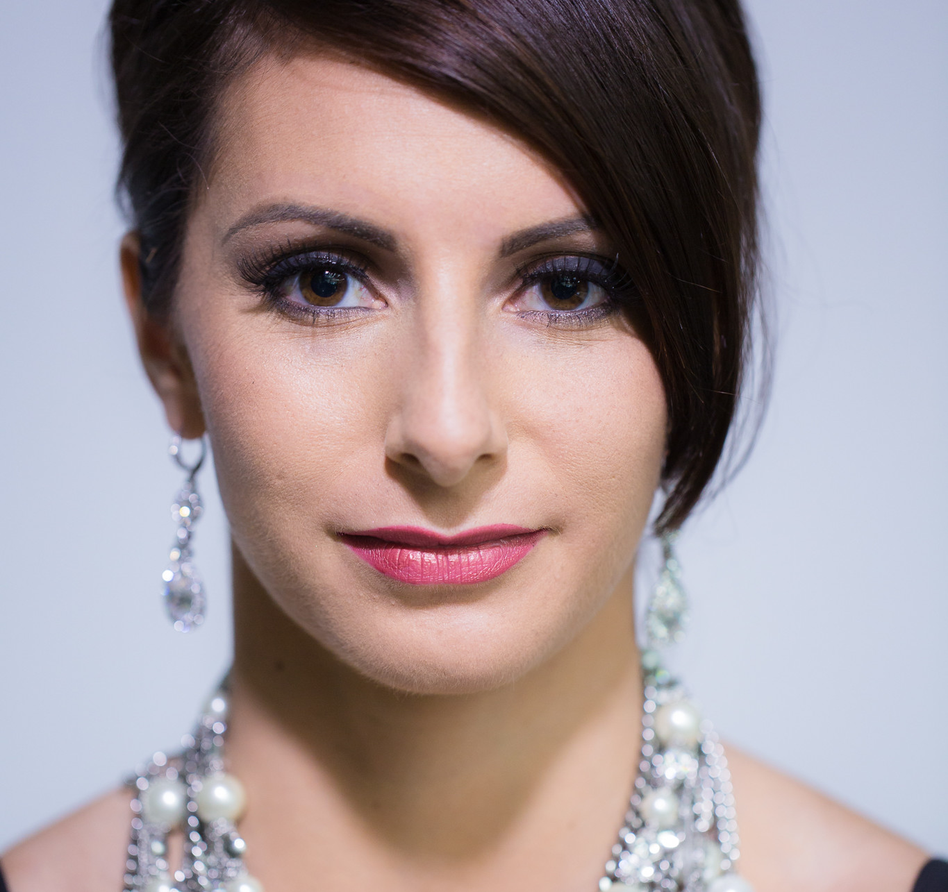
Butterfly Lighting or Paramount Lighting
Butterfly Lighting is achieved by positioning the main light directly in front of the subjects face and adjusting the height to create a shadow directly under, and in line with, the nose.
The term comes from a butterfly shaped shadow beneath the subject's nose.
This style is best suited for subjects with a normal oval face and is considered to be a glamour style of lighting.

Slide 5
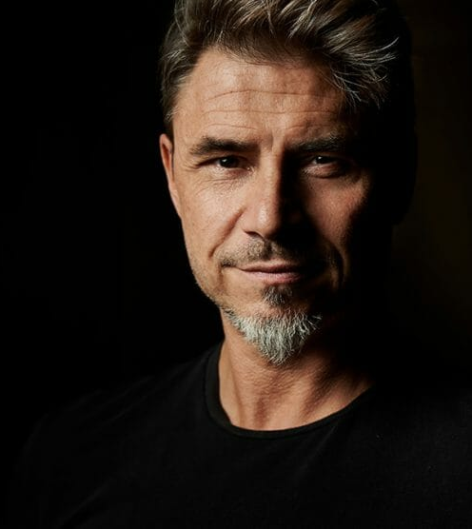
45 Degree or Rembrandt Lighting
Rembrandt Lighting lighting is obtained by combining short lighting and butterfly lighting.
Direct your Main Light toward your subject's face at an angle of approximately 45 degrees.
The main light is positioned high and on the side of the face that is away from the camera.
This technique produces an illuminated triangle on the cheek closest to the camera. The triangle will illuminate just under the eye and not below the nose.

Slide 6
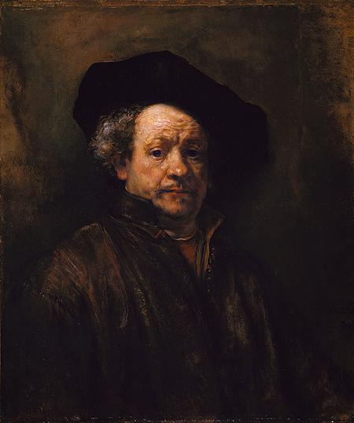
45 Degree or Rembrandt Lighting
Rembrandt, the master painter used a technique of setting his subjects near a large north-facing window (so no direct sunlight would hit the subject) and turning them in relation to the window to create flattering lighting effects that really emphasized the high spots and depths of his subject's face.
Self-Portrait, Oil on canvas,
31 5/8 x 26 1/2 in. 1660

Slide 7
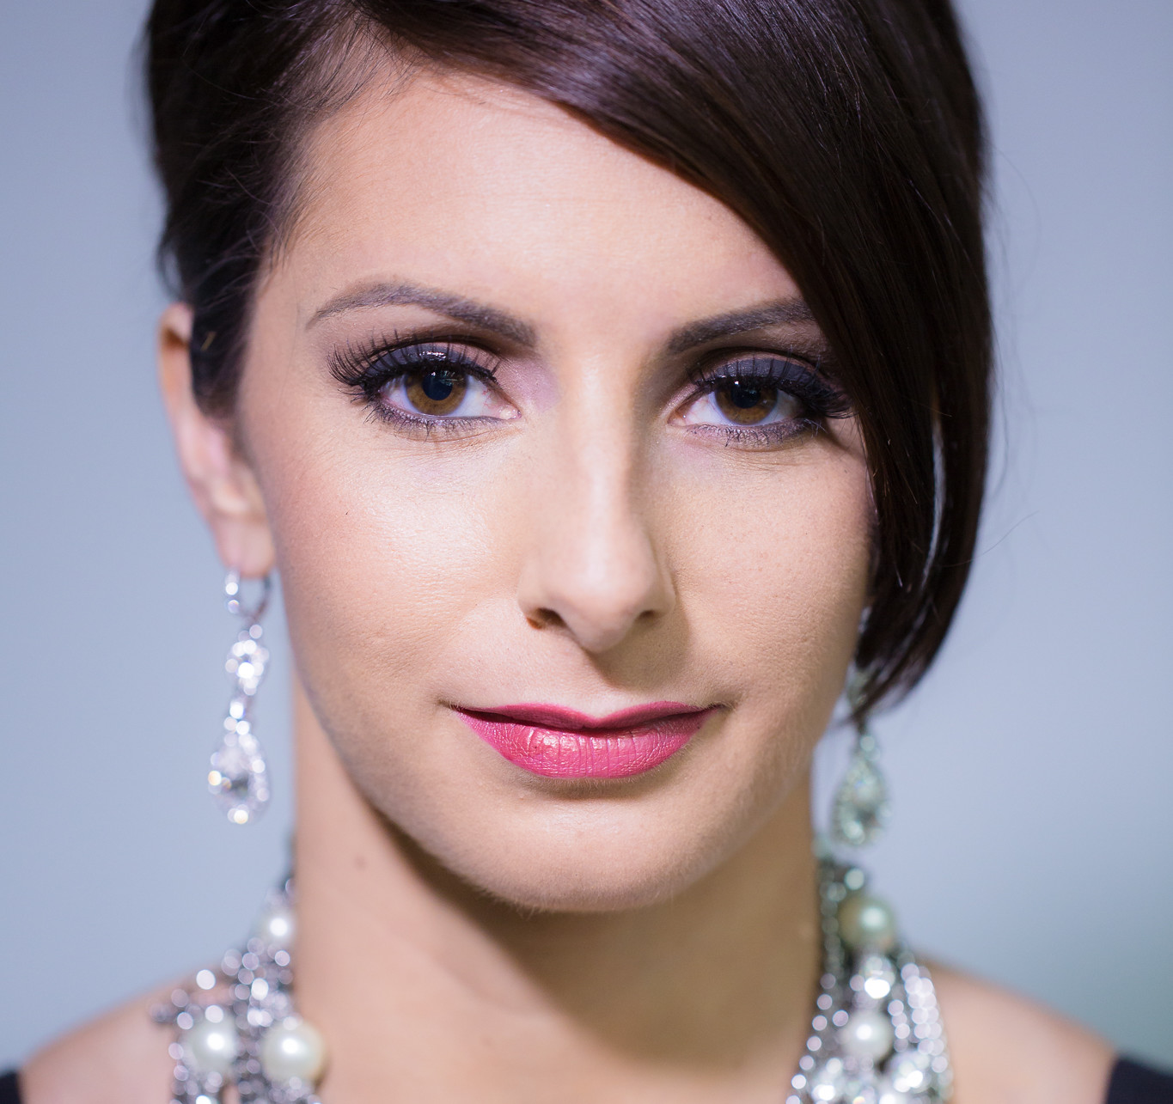
Loop Lighting
Loop lighting is a portrait lighting pattern where the subject is lit from about 45 degrees in front of them and above.
This creates a nose shadow that 'loops' down at an angle onto their cheek. It is a slightly directional lighting pattern - the light is not flat, but the face is still mostly illuminated.

Slide 8
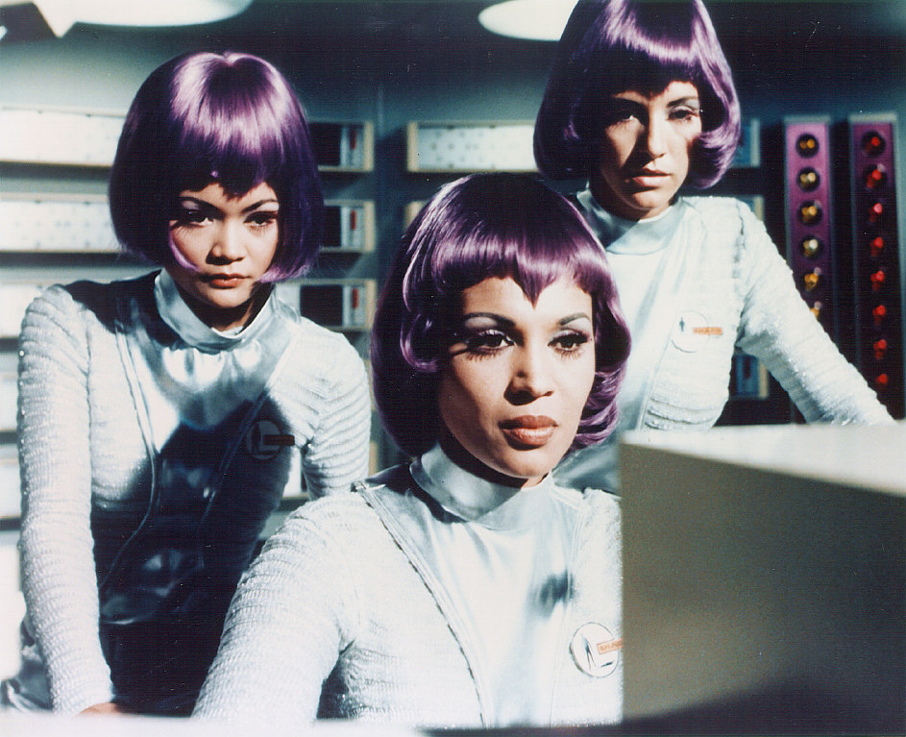
Lighting Hair
Hair Light. The hair light is a lower power light that illuminates the subjects hair providing separation from the background. This is especially important when photographing a subject with dark hair against a dark background.

Slide 9
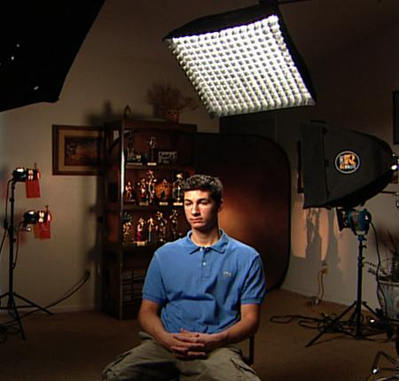
Lighting Hair
To properly place a hair light, you should bring the light forward enough to let the light spill onto the subjects face, then slowly move it back until the light disappears from the subjects skin.

Slide 10
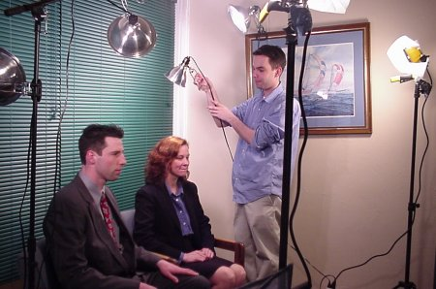
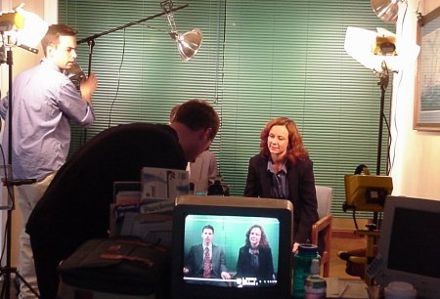
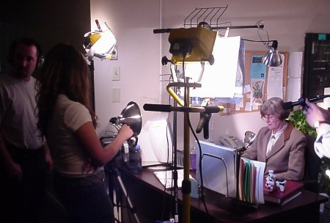
DYI Lighting
Examples of lighting setup for a video shoot.

Slide 11
Depth of Field
F3.2
F3.6
F4
F4.5
F5
F5.6
F6.4
F7.1
F8
F9

